Slide 1
Sankey Diagrams
Learning Intentions:
To be able to read and interpret Sankey diagrams.
To be able to draw Sankey diagrams.
Key Word:
Sankey Diagrams, input energy, output energy, useful energy, wasted energy

Slide 2

You might have seen energy efficiency ratings on a new fridge or washing machine.
Rate the devices on their efficiency.
The more stars on the label, the more efficient – which means it may cost less to run.

Slide 3
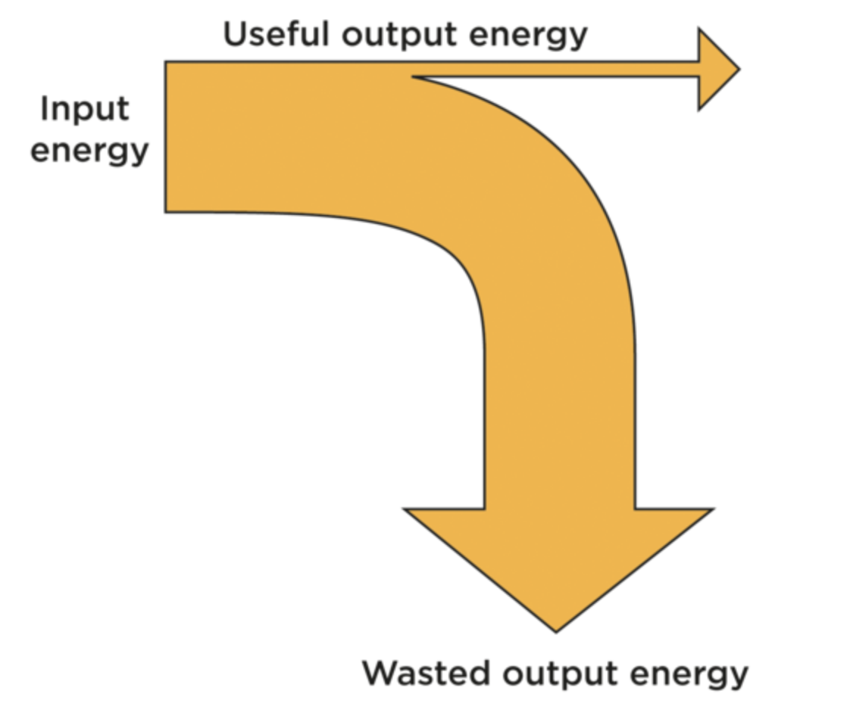
We can use a Sankey diagram to show how the energy is transformed from input energy to output energies.
The output energy is made up of useful energy (arrow at the top) and wasted energy (arrow going to the bottom).

Slide 4
Sankey Diagrams
Notice the thickness of the input energy arrow = total thicknesses of the output arrows
This is because of the Law of Conservation of energy.

Slide 5

What is the fluorescent bulb saying to the incandescent bulb?

Slide 6
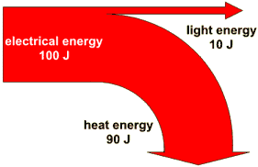
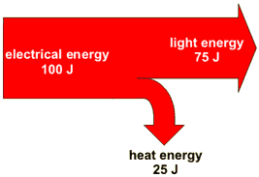
Incandescent light vs a saving light bulb

Slide 7



Look at these appliances and work out the missing numbers
Television (1hr)
Input | Output
Electricity = 700 kJ | Light = 150 kJ
 | Sound = _______
 | Heating = 360 J
Hair dryer (10min)
Input | Output
Electricity = 900 kJ | Motion = 60 kJ
 | Heating = 540 kJ
 | Sound = _______
Vacuum cleaner
(30min)
Input | Output
Electricity 800 W x 30 min (1800 sec) = 1,440 kJ | Motion = 430 kJ
 | Heating = ____
 | Sound = 100 kJ
Notes:
These values are based off an average power rating for each of the example appliances.
TV = 200 W
Hairdryer = 1500 W
Vacuum cleaner = 800 W
‹#›

Slide 8

What is the big car telling the small car ☺?

Slide 9
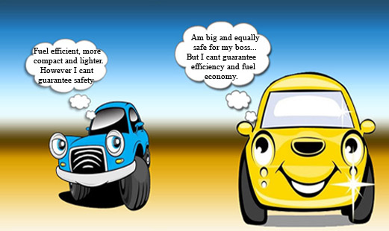

Slide 10
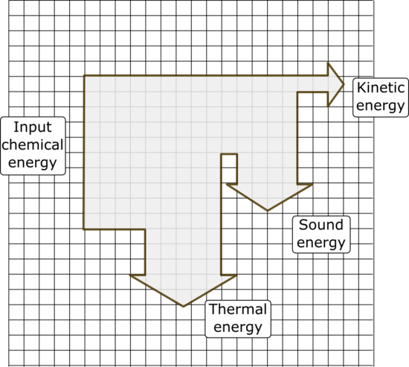
Sankey diagram for a car engine

Slide 11
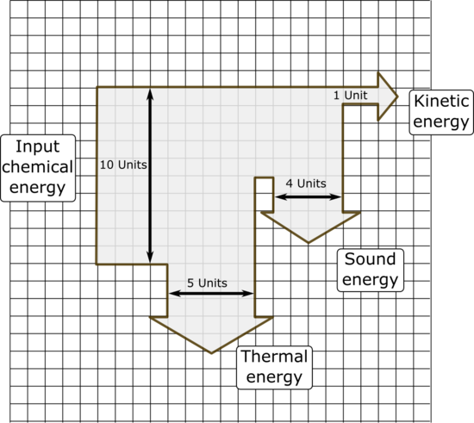
The Sankey Diagram for a car engine with measurments
What do you notice about the sum of the output energies?

Slide 12
Calculating energy efficiency
Energy efficiency tells us how much of the input energy is converted into useful energy, instead of being wasted (lost).
Formula:
Efficiency = Useful Energy x 100
Input Energy
Efficiency is given as a percentage (%)

Slide 13
Wasted energy
Wasted energy, energy lost to the surroundings, is the amount of energy that does not get converted into a useful form of energy.
Formula
Wasted energy (J) = Input energy (J) - Useful energy (J)
Example: When the electronics in a computer heat up, it indicates that some of the electrical energy is being wasted as heat energy. The more heat energy that is produced, the less efficient the device is.

Slide 14
Look back at these appliances and work out Efficiency of each
Television (1hr)
Input | Output
Electricity = 700 kJ | Light = 150 kJ
 | Sound = _______
 | Heating = 360 J
Hair dryer (10min)
Input | Output
Electricity = 900 kJ | Motion = 60 kJ
 | Heating = 540 kJ
 | Sound = _______
Vacuum cleaner
(30min)
Input | Output
Electricity 800 W x 30 min (1800 sec) = 1,440 kJ | Motion = 430 kJ
 | Heating = ____
 | Sound = 100 kJ
Notes:
TV = 51%
Hairdryer = 67%
Vacuum cleaner = 30%
‹#›

Slide 15
Activity - Sankey diagram worksheet
Complete the questions from the Sankey diagram worksheet.

